Slide 1
B.A Third Year
Semister 5 2019-20
Understanding Drama

Slide 2
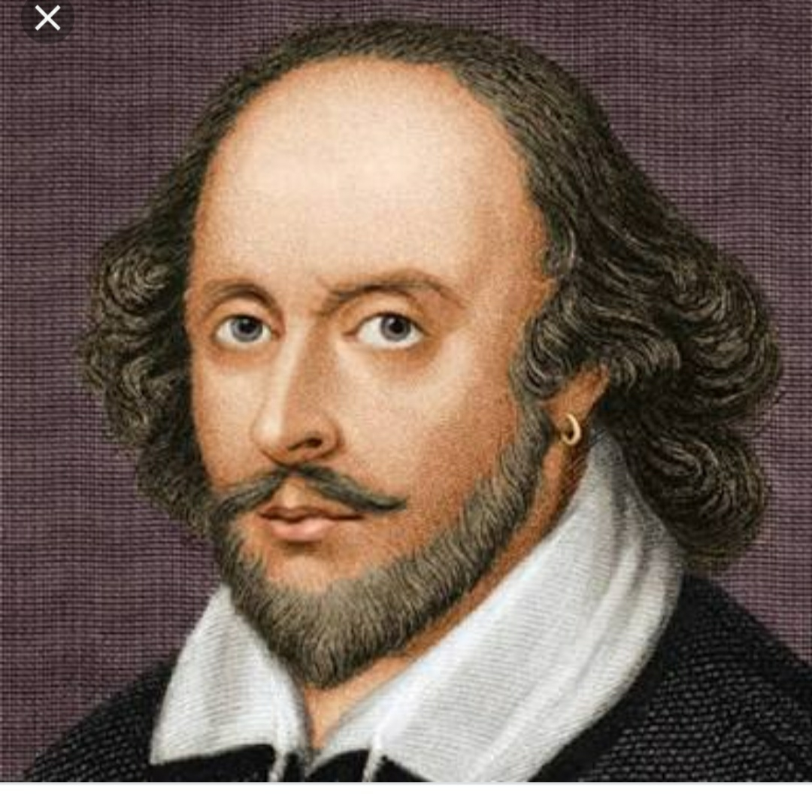
Definition and Elements of Drama

Slide 3
Definition

Slide 4
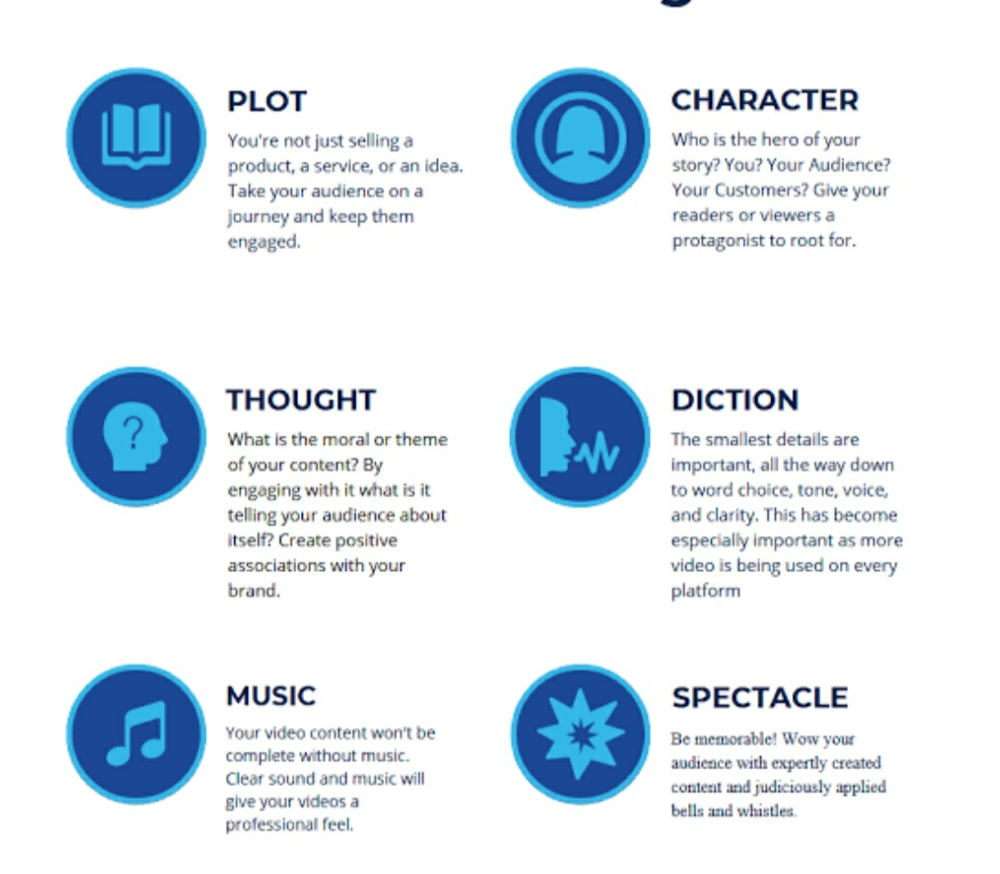
Elements of Drama
Diction.

Slide 5
